Slide 1
A presentation on how
Election should be conducted. Python Online
Reymond, Ssengendoreymond@gmail.com.

Slide 2
Election simulation project.
Requirements
Python 3.x
Matplotlib
Nump
Code Structure.
voter.py: contains the Voter class which manages voter details and eligibility.
Election.py: contains the Election class which manages the election process, including voter registration, vote casting and result visualization.
Election simulation.py.: Main script to run the election simulation.

Slide 3
Objective
To simulate an Election process using python.
To practise and improve Object-oriented programming and data visualization skills.
To create an engaging and interactive learning tool.
To develop analytical skill through data collection , analysis and interpretation.
Results
Winner Announcement: The candidate with the most votes wins
Visualization: Pie chart for overall results and bar chart for district wise results

Slide 4
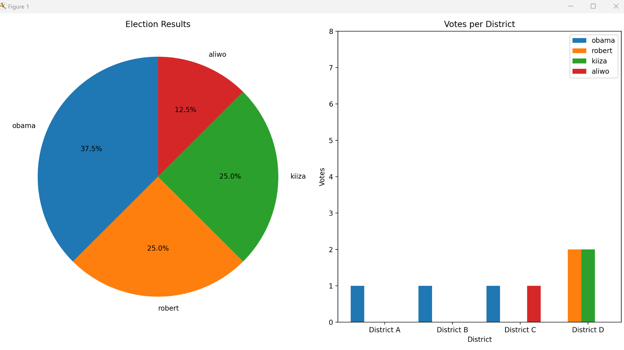

Slide 5
Thank you

